Slide 1
Personal Software ProcessSM for Engineers: Part II
Tutorial: Using PSP2.1

Slide 2
Tutorial Objectives
After this tutorial, you will
  understand the new elements of PSP2.1
  know how to use the PSP2.1 scripts and forms
  be prepared to use PSP2.1 for programs 6, 7, and 8

Slide 3
PSP2.1 Objectives
The objectives of PSP2.1 are to introduce
  additional measures for managing process quality
  design templates that provide an orderly framework and format for recording designs

Slide 4
New Process Elements
PSP2.1 adds the following process elements:
  PSP2.1 design review script
  PSP2.1 design review checklist
  operational specification template
  functional specification template
  state specification template
  logic specification template
The design templates are discussed in the lectures on state machines and software design.

Slide 5
Project Plan Summary Example
We will walk through an example of a completed PSP2.1 project plan summary.
Only the new items on this form are discussed.

Slide 6
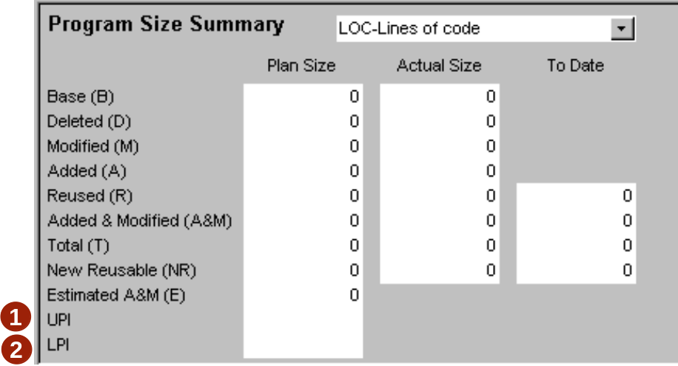
Program Size Prediction Intervals
Program size prediction intervals are automatically
calculated using the method described in the text.
  UPI – upper prediction interval
  LPI – lower prediction interval
These values are calculated only if PROBE method A or B
is used.

Slide 7
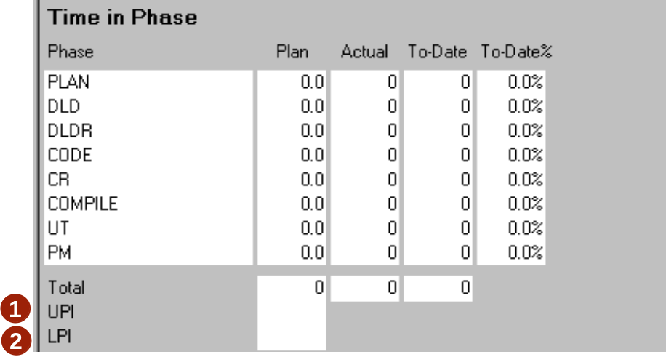
Development Time Prediction Intervals
Development time prediction intervals are automatically
calculated using the method described in the text.
  UPI – upper prediction interval
  LPI – lower prediction interval
These values are calculated only if PROBE method A or B
is used.

Slide 8
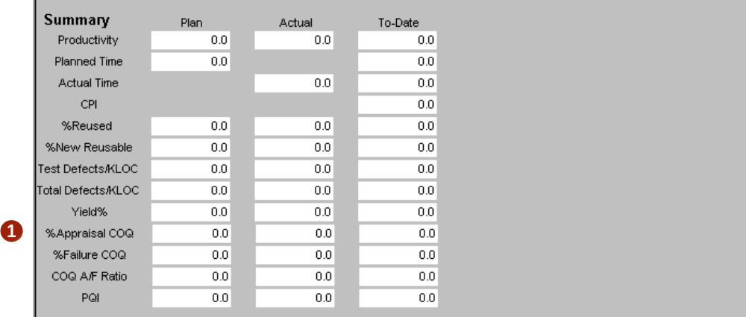
Summary: Percent Appraisal COQ
  % Appraisal Cost of Quality is the percentage of development time spent in design review and code review.

Slide 9
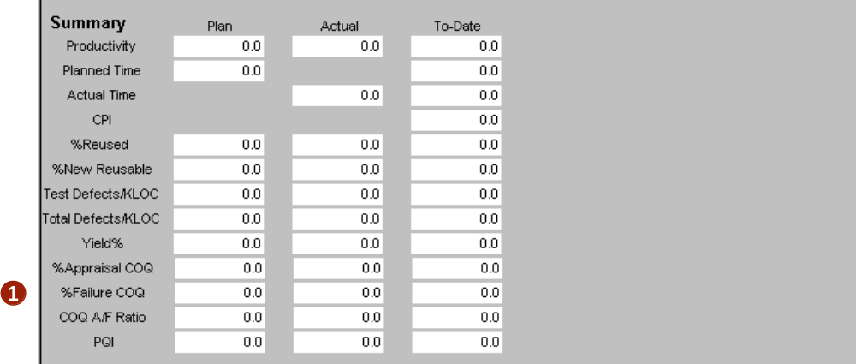
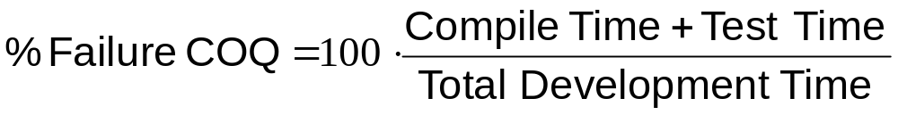
Summary: Percent Failure COQ
  % Failure Cost of Quality is the percentage of development time spent in compile and test.

Slide 10
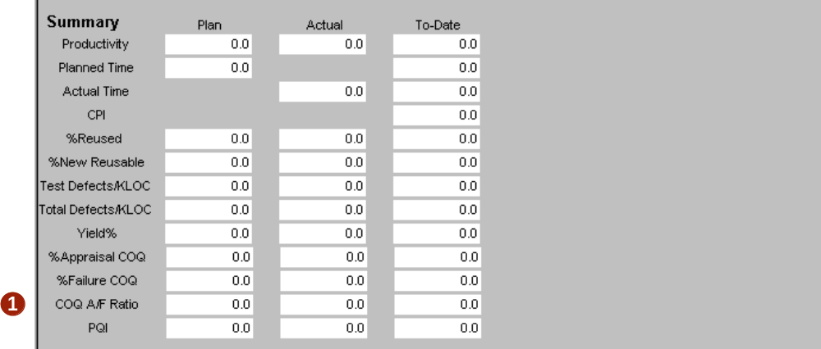
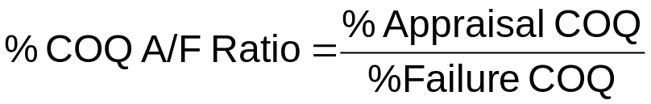
COQ A/F Ratio
  COQ A/F Ratio is the ratio of appraisal costs to failure costs.

Slide 11
Messages to Remember
PSP2.1 provides data that allows you to manage the cost of improving the quality of the programs you write.
The design templates will help you to record and document your design, making it easier to review.

